Slide 1
ELECTRIC EYE
TEAM LEADER:FAUZAIL KARNAR
TEAM MEMBERS:
KSHITIJ JANDE
VIRAJ GARG
SACHIN RAI

Slide 2
VISION TO SUPPORT VISUALLY IMPAIRED PEOPLE

Slide 3
PROBLEM STATEMENT
The challenges faced by blind people while performing outdoor activities are plenty.
For Example: Looking for particular spot or destination, crossing the road.
The latest technology like google maps or navigation system speed monitoring system they have failed to address the basic problem faced by visually impaired group of people in the world.

Slide 4
SOLUTION STATEMENT
We aim to build the device that is abled with speech analysis that can help the blind person in guiding to reach the destination.
The device is enabled with object sensor that can identify the presence of vehicle within a certain diameter of the person until they cross the road.
The device will also inform other people that a blind person is crossing the road.

Slide 5
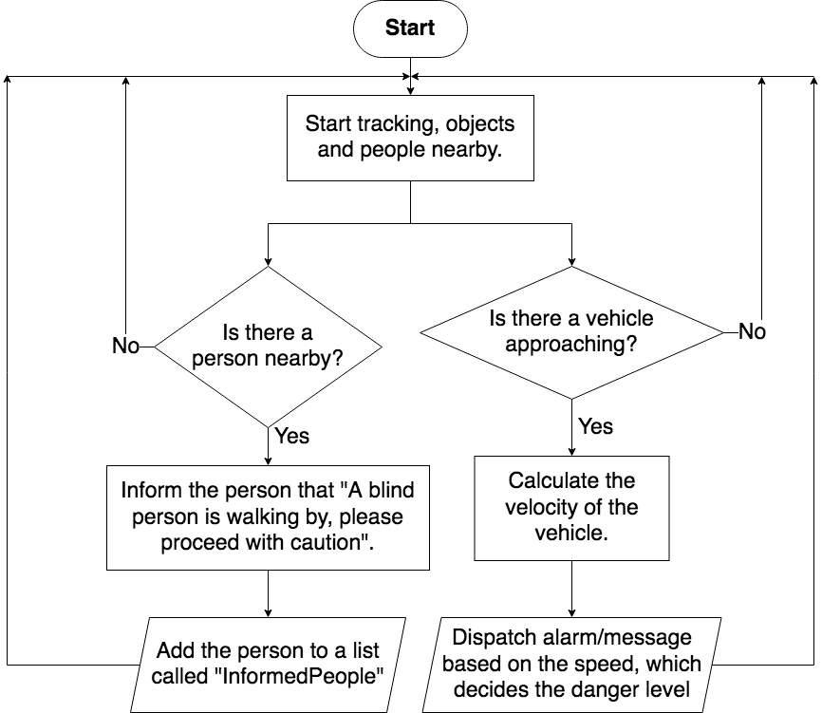
FLOWCHART
THIS IS HOW OUR MODEL WORKS (FLOWCHART):
Components:
Arduino Mega
GMR Sensor
Grove – Speech Recognizer
Active Buzzer

